Slide 1
Discrete Mathematics Lecture #1

Slide 2
Recommended Textbook
Discrete Mathematics and Its Applications by Kenneth H. Rosen

Slide 3
From http://dictionary.oed.com:
Discrete adj.
1. a. Separate, detached from others, individually distinct. Opposed to continuous.
2. a. Consisting of distinct or individual parts; discontinuous.
According to writer Kenneth H. Rosen-
Discrete mathematics is the part of mathematics devoted to the study of discrete objects.

Slide 4
Application Area
Advanced algorithms & data structures
Programming language compilers & interpreters.
Computer networks
Operating systems
Computer architecture
Database management systems
Cryptography
Error correction codes
Graphics & animation algorithms, game engines, etc.…
I.e., the whole field!

Slide 5
Today’s Topics
Basic Propositional Logic
Variable Based Propositional Logic
Logical Operators

Slide 6
Proposition
Definition
A proposition is a declarative sentence (that is, a sentence that declares a fact) that is either true or false, but not both.
Example
Washington, D.C., is the capital of the United States of America
Dhaka is the capital of Bangladesh
Dhaka is the capital of India
8 + 2 = 10 , 2 + 1= 3
4 + 4 = 10

Slide 7
Proposition or Not?
What time is it?
Read this carefully.
a + 2 = 10
x + y = z

Slide 8
Propositional Variable
Definition
variables that represent propositions, just as letters are used to denote numerical variables.
The conventional letters used for propositional variables are p, q, r, s, ... .
Example :
p = Dhaka is the capital of Bangladesh.

Slide 9
Some common terms
The truth value
The truth value of a proposition is true, denoted by T, if it is a true proposition, and the truth value of a proposition is false, denoted by F, if it is a false proposition.
p = Dhaka is the capital of Bangladesh.
Truth value : T
p = Dhaka is the capital of Pakistan.
Truth value : F

Slide 10
Some common terms
Propositional Calculus or Propositional Logic.
The area of logic that deals with propositions is called the propositional calculus or propositional logic.
Compound Propositions
New propositions formed from existing propositions using logical operators are called compound propositions.

Slide 11
Introduction to Logical Operators
Similar to algebraic operators + * - /
Basic Operators
Negation (NOT)
Conjunction (AND)
Disjunction (OR)

Slide 12
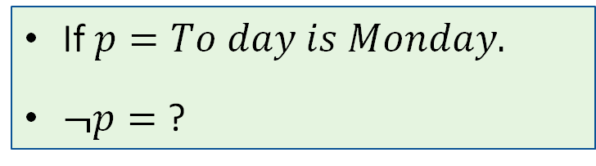
Logical operators: Not
Definition
A “not” operation switches (negates) the truth value.
Symbol: ¬ or ~
Truth table
P | ¬p
T | F
F | T
If $p=To day is Monday.$
$¬p=$ ?

Slide 13
Logical operators: And
Definition
An “and” operation is true if both operands are true.
Symbol: ∧
p | q | p∧q
T | T | T
T | F | F
F | T | F
F | F | F
p = “Today is Friday”
q = “Today is my birthday”
p∧q = ?
p∧q = “Today is Friday and today is my birthday”

Slide 14
Logical operators: Or
Definition
An “or” operation is true if either operands or both are true.
Symbol: ∨
p | q | p∨q
T | T | T
T | F | T
F | T | T
F | F | F
p = “Today is Friday”
q = “Today is my birthday”
p ∨ q = ?
p ∨ q = “Today is Friday or today is my birthday”

Slide 15
More Logical Operators
More Operators
Exclusive OR
Conditional
Bicondition

Slide 16
Logical operators: Exclusive Or
Definition
Let p and q be propositions. The exclusive or of p and q, denoted by p⊕q, is the proposition that is true when exactly one of p and q is true and is false otherwise.
Symbol: ⊕
Often called XOR
p⊕q ≡ (p ∨ q) ∧ ¬(p ∧ q)
p | q | p⊕q
T | T | F
T | F | T
F | T | T
F | F | F
p⊕q = “Today is Friday or today is my birthday, but not both”

Slide 17
Logical operators: Conditional
Definition
Let p and q be propositions. The conditional statement p→q is the proposition “if p, then q.” The conditional statement p→q is false when p is true and q is false, and true otherwise.
p→q = “If today is Friday, then today is my birthday”
In the conditional statement p→q,
p is called the hypothesis (or antecedent or premise)
q is called the conclusion (or consequence)

Slide 18
Logical operators: Conditional
p → q = ¬p∨ q
p | q | p→q
T | T | T
T | F | F
F | T | T
F | F | T
the
antecedent
the
consequence
I will do only for myself
Let, p = “Maria learns discrete mathematics” and
q = “Maria will find a good job.”
Express the statement p→q as a statement in English.
If I am elected, then I will lower taxes.

Slide 19
Logical operators: Bi-Conditional
Definition
Let p and q be propositions. The biconditional statement p↔q is the proposition “p if and only if q.” The biconditional statement p↔q is true when p and q have the same truth values, and is false otherwise.
Biconditional statements are also called bi-implications.
“p is necessary and sufficient for q”
“if p then q, and conversely”
“p iff q.”

Slide 20
Logical operators: Bi-Conditional
True when both has same truth values and otherwise false.
p | q | p↔q
T | T | T
T | F | F
F | T | F
F | F | T
Alternatively, it means “(if p then q) and (if q then p)” (p→q)∧ (q→p).
Note that a bi-conditional has the opposite truth values of the exclusive or
Let p = “You take this class” and q = “You get a grade”
p↔q = “You take this class if and only if you get a grade”
Alternatively, it means “If you take this class, then you get a grade and if you get a grade then you take (took) this class”

Slide 21
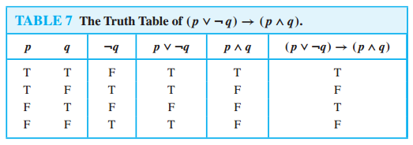
Truth Tables of Compound Propositions
Example
Construct the truth table of the compound proposition
(p∨¬q)→(p∧q).

Slide 22
Boolean operators summary
 |  | and | or | xor | conditional | Bi-conditional
p | q | p∧q | p∨q | p⊕q | p→q | p↔q
T | T | T | T | F | T | T
T | F | F | T | T | F | F
F | T | F | T | T | T | F
F | F | F | F | F | T | T
Learn what they mean, don’t just memorize the table!

Slide 23

Precedence of operators
Just as in algebra, operators have precedence
4+3*2 = ?
4+3*2 = 4+(3*2)
4+3*2 = (4+3)*2

Slide 24
Precedence of operators
p ∨ q ∧ ¬r → s ↔ t = ?
=(p ∨ (q ∧ (¬r)) → s) ↔ (t)
First three are the most important
NOT is always performed before any other operation
Operators | Precedence
¬ | 1
∧ | 2
∨ | 3
→ | 4
↔ | 5

Slide 25
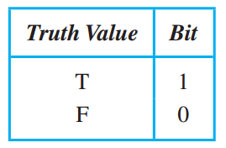
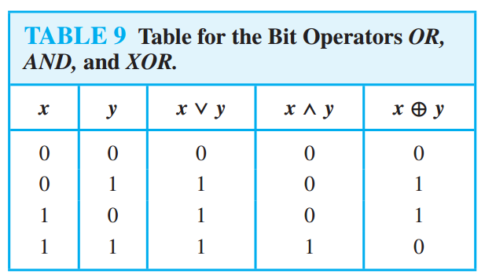
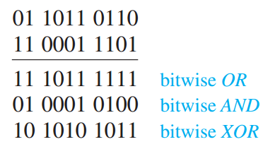
Logic and Bit Operations

Slide 26
Applications of Propositional Logic
Translating English Sentences
System Specifications
Boolean Searches
Logic Puzzles
Logic Circuits

Slide 27
Translating English Sentences
Example
p = “It is below freezing”
q = “It is snowing”
It is below freezing and it is snowing
p∧q
It is below freezing but not snowing
p∧¬q
If it is below freezing, it is also snowing
p→q
It is either below freezing or it is snowing, but it is not snowing if it is below freezing
(p∨q)∧(p→¬q)
That it is below freezing is necessary and sufficient for it to be snowing
p↔q

Slide 28
Translating English Sentences
Problem: How can this English sentence be translated into a logical expression?
“You can access the Internet from campus only if you are a computer science major or you are not a freshman.”
Solve:
Let, a = “You can access the Internet from campus,”
c = “You are a computer science major,” and
f = “You are a freshman,”
Then the statement can be represented as a → (c ∨ ¬f).

Slide 29
Translating English Sentences
How can this English sentence be translated into a logical expression?
“You can not ride the roller coaster if you are under 4 feet tall unless you are older than 16 years old.”
Solution: Let q, r, and s represent “You can ride the roller coaster,” “You are under 4 feet tall,” and “You are older than 16 years old,” respectively. Then the sentence can be translated to (r ∧ ¬s) → ¬q.

Slide 30
End of Lesson
Thanks to all !!!

